Slide 1
Demystifying Big Data
Jonathan Mills

Slide 2

Who Is This Guy?
Paige Labs:
Research & Development
Twitter:
@jonathanfmills
Website:
jonathanfmills.com

Slide 3
Big data is like teenage sex: everyone talks about it, nobody really knows how to do it,
everyone thinks everyone else is doing it, so everyone claims they are doing it...

Slide 4
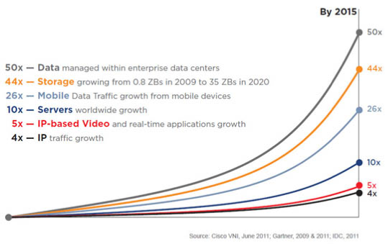
Why Big Data?
Notes:
Its not just that the data is there, you want to be able to DO something with it.

Slide 5



Slide 6
Sql Server’s max DB Size > 3 PB

Slide 7
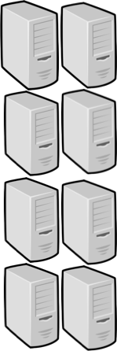
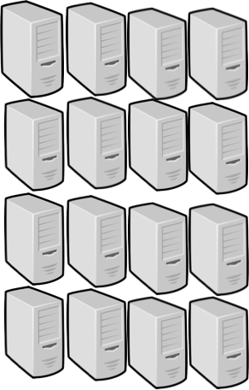



Slide 8


Big Table
DynamoDb

Slide 9
What Is Big Data?

Slide 10

Velocity
Volume
The 3 Vs
Variety

Slide 11
Map Reduce

Slide 12

Notes:
What is Hadoop?
Doug Cutting Nutch spider scrawler….
Open Source Version of Google’s Map reduce plus HDFS File system for managing the data.
3 Copies of everything.
All these servers have disk and CPU. So instead of pulling the data to the code, you push the code to the data

Slide 13



Slide 14
But it doesn’t end there…

Slide 15
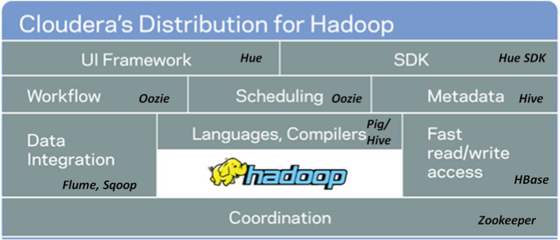

Slide 16
Hadoop vs NoSQL

Slide 17
#
Why NoSQL?
Notes:
Johan Oskarsson in 2009 organizing an event

Slide 18
Schema-less
Cluster Friendly
Open Source
Non-Relational
NoSQL Characteristics

Slide 19










Slide 20
Column Family
Document
Graph
Key Value

Slide 21
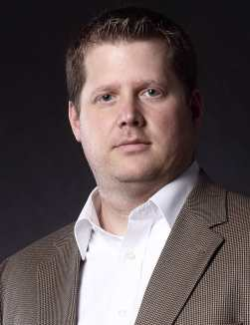
Jmills37
Information….
Password,
Preferences, etc…..
Key Value

Slide 22
Column Family
Jmills37
Jmills37
Security
Preferences
Password: sfjs;ofjsdo;jf
Last Login: 1/27/14
Trusted Devices: XXXXX
Screen Orientation: L
Favorite Stories: adsodkfjsdot
Contact Preference: Push

Slide 23

Document

Slide 24
{
Name: Jonathan Mills,
Title: Director,
Session: Demystifying Big Data
}
Document

Slide 25
{
Name: Jonathan Mills,
Title: Director,
Session: Demystifying Big Data
},
{
Name: Lee Brandt,
Title: Director,
Session: Good Agile, Bad Agile
}
Document

Slide 26




Graph Databases
Worked With
Dave
Works With
Susan
Works With
Mark
Tracy

Slide 27
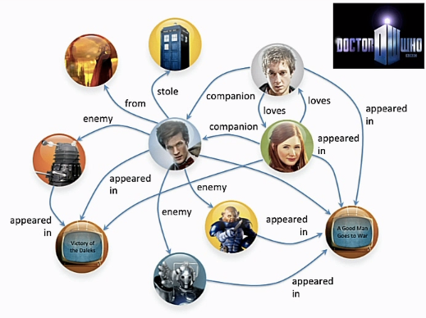
Graph Databases

Slide 28
Column Family
Document
Graph
Key Value

Slide 29


Column Family
Document
Graph
Key Value

Slide 30
Why Big Data?

Slide 31

Customer Insights

Slide 32
The Next Netflix Series
Political Dramas
British Shows
Kevin Spacey
David Fincher
Notes:
David Fincher – Alien3, Seven, The Girl With The Dragon Tattoo, Zodiac, The Game….

Slide 33
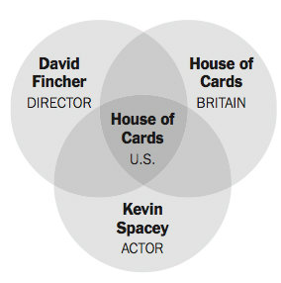
House Of Cards?

Slide 34

Forecasting Trends

Slide 35
Healthcare Trends

Slide 36
What about us?

Slide 37
Why Do I Need To Know?

Slide 38
Evade The Hype…..

Slide 39
Don't Start With The Data

Slide 40
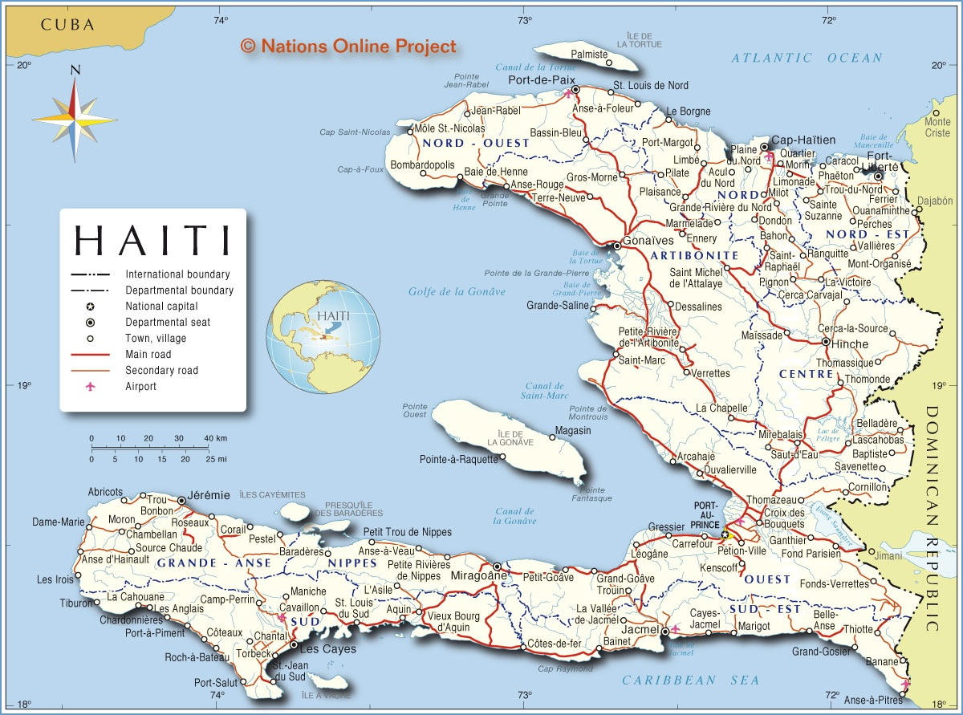
Be a Skeptic

Slide 41
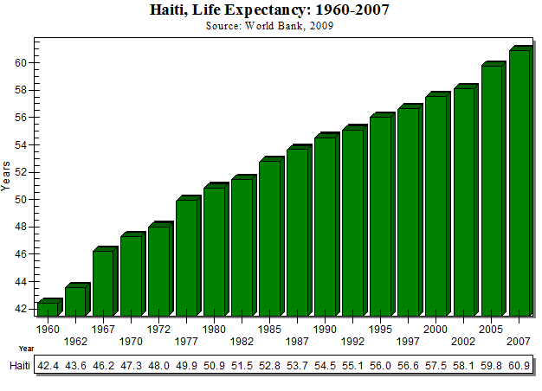
Notes:
The data was not flawed. The assumptions based on the data was bad.

Slide 42
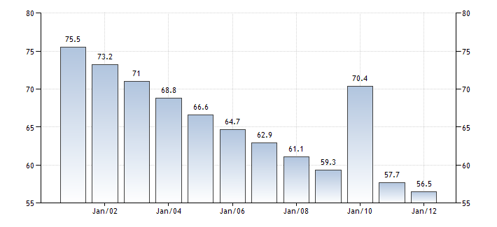

Slide 43
Notes:
The data was not flawed. The assumptions based on the data was bad.

Slide 44

Questions?

Slide 45
Who Is This Guy?
Paige Labs:
Research & Development
Twitter:
@jonathanfmills
Website:
jonathanfmills.com

